Slide 1
Hopping Robot Update VIII
Experimental Setup cont.
&
Looking Towards Paper

Slide 2
Literature
FLEGX: a bioinspired design for a jumping humanoid leg

Slide 3
Current Objective
Validate/improve simulation with experiments
Design experimental setup to capture:
Forces (load cell)
Jump height (cameras)
Power consumption (V/I sensor)
Outline paper

Slide 4
Voltage Current Sensor
Sparkfun sensor broke
Ordered 3 from Adafruit

Slide 5
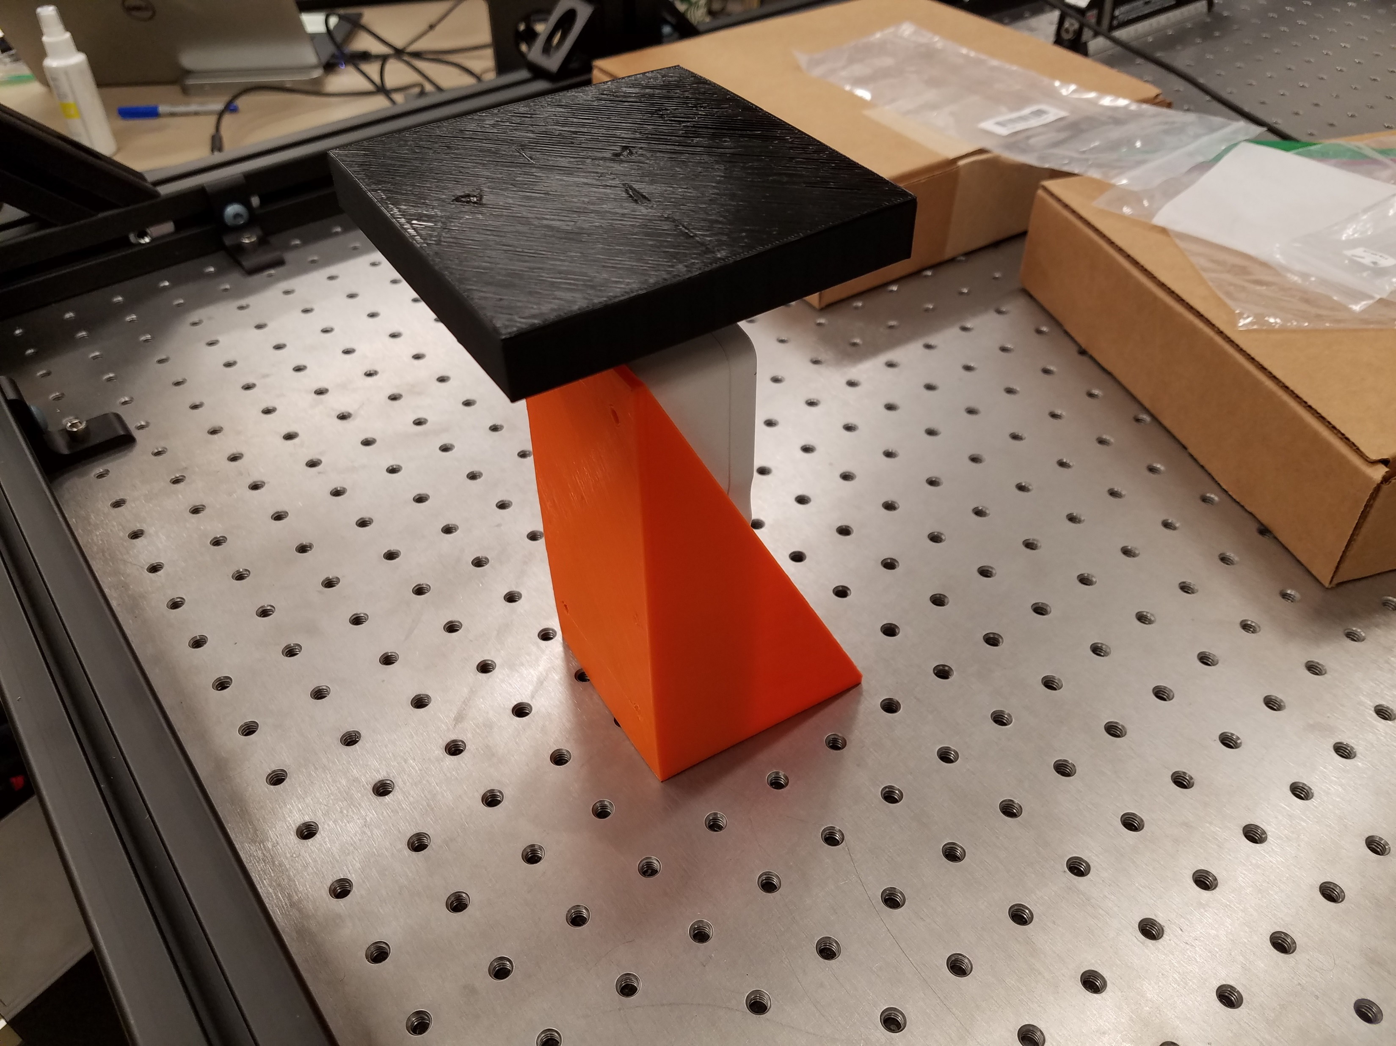
Force Plate / Load Cell
Single axis, low range load cell
Stand & plate
Capture data over usb/serial

Slide 6
Add Cross-section/Material to Model
Unity sim indicates certain optimal amount of stiffness
ie stiffest is not best for maximizing jump height
Consider internal gear ratio, length, & “stiffness”
With mass determined by (length and “stiffness”)
Stiffness could be different widths, thicknesses, shapes, materials

Slide 7
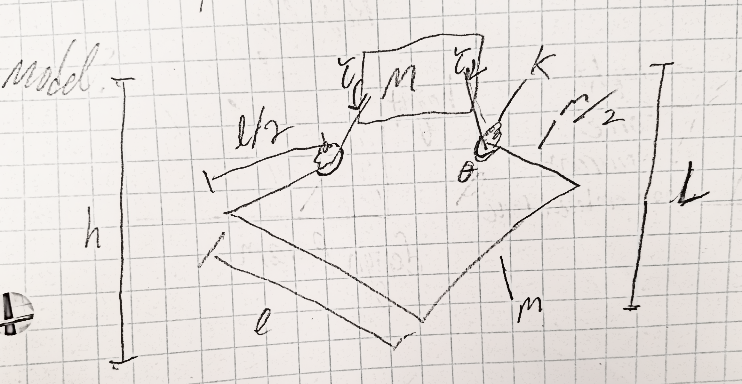
Paper Figures
Drawing of leg platform and simplified model representation
Superimposed on each other?
Jump height vs design variables from sim
Actual jump heights from experiment plotted on top
Someway to show energy out/in of multiple designs
Efficiency?
Show validation of embedded torque sensing

